Slide 1
Billing And Invoicing System
K. Shiva kumari
B. Mahima
B. Shreya
K.V. Nandini
Sanjana
3BR23EC075
3BR23EC017
3BR23EC021
3BR23EC072
3BR23EC143

Slide 2
INTRODUCTION
In today's competitive market,
efficient client billing is crucial for
maintaining cash flow. This
presentation will explore a
comprehensive approach to invoice
creation and due amount calculation,
ensuring timely payments and
improved client relationships.

Slide 3
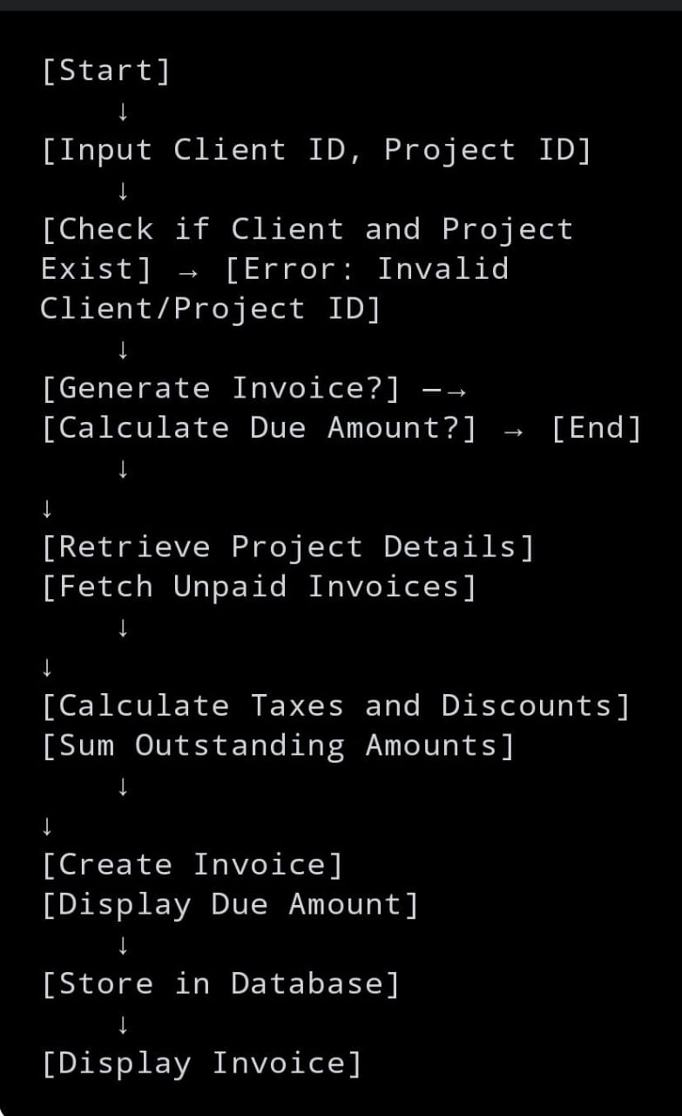
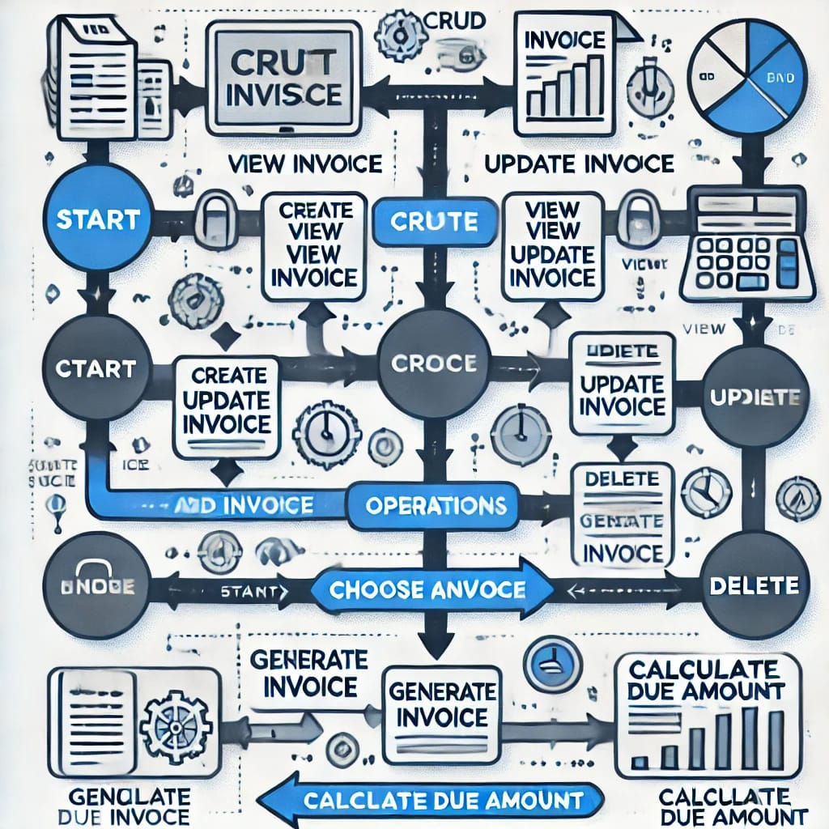

Slide 4
Add Invoice:
View Invoice:
Function view in voice(invoice id): Retrieve invoice by invoice id Return invoice or "Invoice not found"
Function add_ invoice(client _id, project _id, amount): Create invoice with client id, project id, amount Save to database
Update Invoice:
Function update invoice(invoice id, new data): Find invoice by invoice id If found, update with new data and save
Delete Invoice:
Function delete invoice(invoice id): Find invoice by invoice id If found, delete from database
Generate Invoice:
Function generate invoice(client id, project id): Calculate project cost Create and save invoice with client id and project id
Calculate Due Amount:
Function calculate due amount(client id): Retrieve unpaid invoices for client id Return sum of all unpaid amounts

Slide 5
PURPOSES
1. Manage Client Invoices: Provide a structured way to create, read, update, and delete (CRUD) invoices associated with specific clients and projects.
2. Generate Accurate Invoices: Automatically generate invoices based on project data, ensuring accurate billing for clients without manual errors.
3. Track Outstanding Payments: Allow businesses to track the total amount due from clients by calculating outstanding invoices, making it easy to follow up on unpaid balances.
4. Improve Operational Efficiency: Reduce the time and effort required to manage invoices, allowing for smoother financial operations and better client relationships.

Slide 6
ADVANTAGES AND DISADVANTAGES
1. Efficiency and Automation: The system automates the invoicing process, saving time and reducing manual workload by quickly generating, updating, and managing invoices.
2. Accuracy in Billing: Automated invoice generation reduces errors in calculating amounts, ensuring clients are billed correctly based on project data.
3. User-Friendly Interface: A well-designed system makes it easy for users to create, update, and manage invoices without requiring extensive training or technical knowledge.
1. Initial Setup and Costs: The system may require an upfront investment for development, deployment, and training, especially for custom features or large-scale businesses.
2. Dependence on System Reliability: The system may face technical issues such as downtime, bugs, or data loss if not properly maintained, leading to delays in billing and payment processes.
3. Data Security and Privacy Risks: Handling sensitive financial and client data carries the risk of breaches, requiring robust security measures to protect information.

Slide 7
CONCLUSION
The billing and invoicing system enhances operational efficiency by automating invoice management, ensuring billing accuracy, and streamlining payment tracking. While it requires initial setup and ongoing maintenance, the benefits of improved cash flow management, centralized records, and reduced manual errors make it a valuable asset for businesses. Proper implementation and security measures ensure it remains a reliable and effective solution for managing financial processes.

Slide 8
THANK YOU

